Slide 1
Design and Development of Autonomous Precision Farming Robot
Interim Presentation
Project Work-I B-TECH, EEE
Batch 2022

Slide 2
Group Details
Sl. No. | Reg. No. | Name of the student
1 | 21ETEE003011 | Jhenkar RS
2 | 21ETEE003023 | R Bharani Bhushan
3 | 22ETEE003002 | G Harshavardhan Reddy
4 | 21ETEE003005 | BG Darshan

Slide 3
Title of the Project
Design and Development of Autonomous Precision Farming Robot
Supervisor
Dr. Kiran Kumar B M
Place of Work : RTC, Peenya

Slide 4
Outline
Introduction
Title and Aim
Objectives
Block Diagram or Concept
Outcomes
Gantt Chart
References

Slide 5
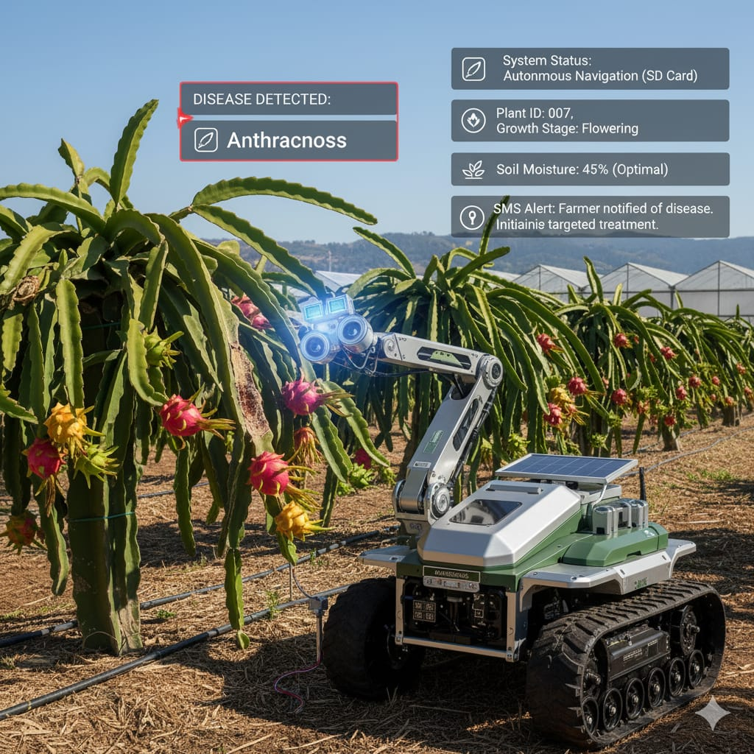
Introduction
Exotic plants such as dragon fruit, orchids, saffron, poppy flowers and strawberries are highly sensitive and require precise care.
Manual monitoring of disease, irrigation, and nutrition is time-consuming and inefficient.
The proposed AgriBot automates the process using Pre stored Data, IoT, and solar power.
It detects diseased plants, communicates with a control unit, and activates targeted fertilizer delivery only to the affected plant.
Figure -1: Agriculture Rover

Slide 6
Literature Review on Agricultural Technologies
Reference | Year | Methodology | Key Findings | Limitations/Gaps
Mohanty et al., 'Using Deep Learning for Image-Based Plant Disease Detection' [1] | 2016 | CNN trained on 54,306 prestored leaf images for 14 crop species and 26 diseases. | Achieved 99.35% accuracy in identifying diseases from prestored data, enabling effective detection of crop deficiencies. | Limited to controlled images; lacks integration with real-time field mobility or IoT for autonomous response.
Ngugi et al., 'Revolutionizing crop disease detection with computational...' [4] | 2024 | Review of image processing and ML for diagnosing and severity assessment of crop diseases. | Prestored datasets effectively detect diseases early, supporting precision agriculture. | Most systems are standalone; few address mobile robots for detection and response.
Al Mamun et al., 'IoT-enabled solar-powered smart irrigation...' [5] | 2025 | IoT sensors for soil moisture monitoring with real-time data-driven irrigation control via wireless networks. | Enables soil-based precision watering and remote monitoring using GSM/wireless, reducing water waste. | Primarily stationary; limited integration with vision systems or high-value crops.
Thakur et al., 'An extensive review on agricultural robots...' [2] | 2023 | Machine vision integration in robots for crop monitoring, including disease spotting. | Vision-enabled robots improve monitoring, but many remain stationary. | Few works on mobile robots combining detection, irrigation, and autonomous fertigation; exotic crops underexplored.
Mac et al., 'Intelligent agricultural robotic detection system...' [6] | 2024 | Fuzzy control and deep learning for autonomous greenhouse navigation and disease classification via vision. | Mobile robots with vision detect diseases and respond autonomously, outperforming standalone tools. | Limited to general crops; needs research on exotic varieties requiring localized care.
S et al., 'Smart Agriculture Robot for Plant Disease Detection...' [7] | 2025 | Raspberry Pi-based image processing with IoT for detection and spraying on a mobile robot. | Integrates vision, IoT communication, and automated response, enabling remote monitoring via wireless. | Standalone disease and irrigation focus persists; gaps in comprehensive platforms for high-value crops.

Slide 7
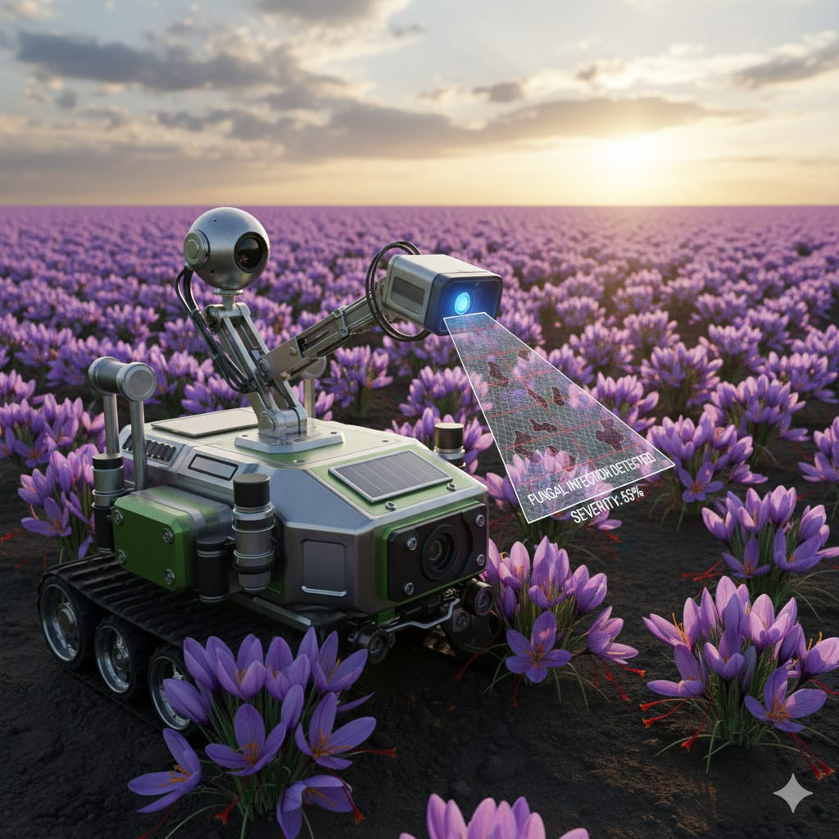
Literature Survey
Image processing models based on prestored data have proven effective in detecting crop diseases and deficiencies.
IoT-enabled irrigation systems allow soil-based precision watering.
GSM and wireless networks enable remote agricultural monitoring.
Vision systems are being integrated into robots for agricultural applications.
Figure-2: Agribot detecting diseases

Slide 8
Literature Survey
Existing systems for disease detection and irrigation are mostly standalone or stationary.
Few works address mobile robots capable of both detection and autonomous response.
There is limited research focused on exotic or high-value crops, which require more precise and localized care.
The proposed LandBot combines Pre stored Data , IoT communication, and automated fertigation in one integrated platform.

Slide 9
Title : Design and Development of Autonomous Precision Farming Robot Aim: To design and develop a Autonomous Precision Farming Robot that utilizes prestored data and IoT technologies to detect plant diseases in exotic crops and enable targeted fertilizer application through individual solenoid valve control.

Slide 10
Objectives
To conduct a comprehensive literature survey on plant diseases and their existing mitigation techniques.
To create a prestored dataset to support accurate identification and classification of plant health conditions.
To develop an image-processing–based approach for real-time detection of plant diseases and nutrient deficiencies in exotic crops.
To develop a rover that autonomously navigates between plants, detects diseases, and reports results for precise treatment.
To establish seamless wireless communication between the AgriBot and the Drip Control Unit for synchronized operation.

Slide 11
Objectives
To automate targeted fertilizer delivery only to affected plants, thereby minimizing resource wastage.
To design a sustainable energy system powered by renewable sources, particularly solar energy, to operate the setup.
To integrate all subsystems—disease detection, irrigation, fertilizer control, and energy management—into a unified smart agriculture framework.
To design and implement an IoT-enabled drip irrigation system with individual solenoid valve control for each plant.

Slide 12
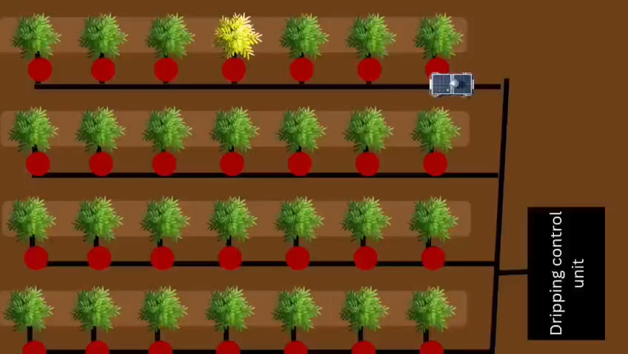
Working concept

Slide 13
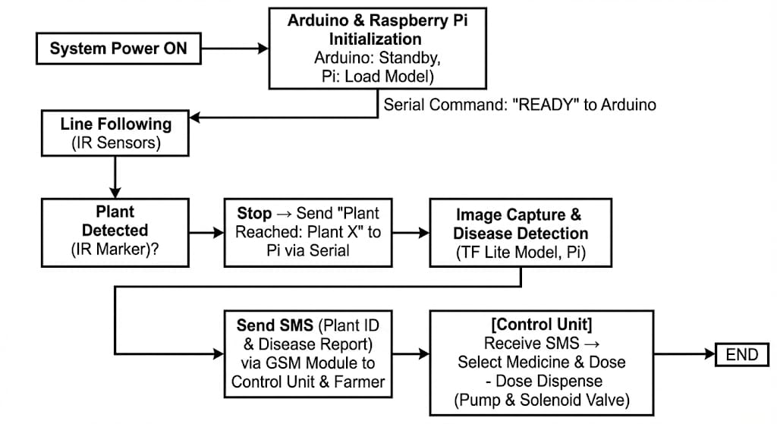
Block Diagram
]
From Pi

Slide 14
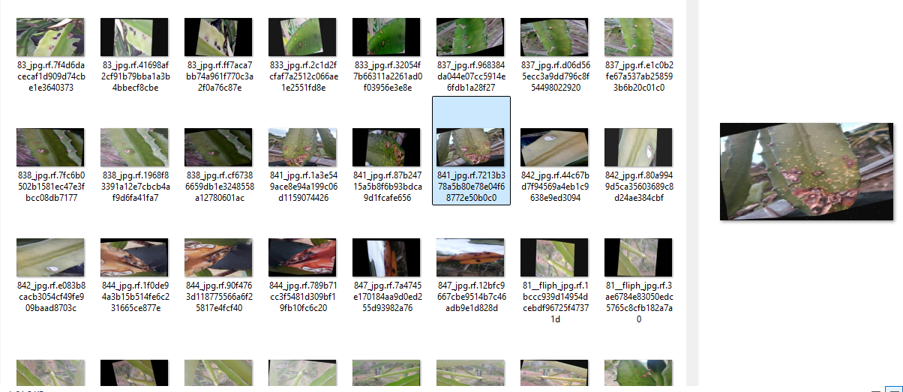
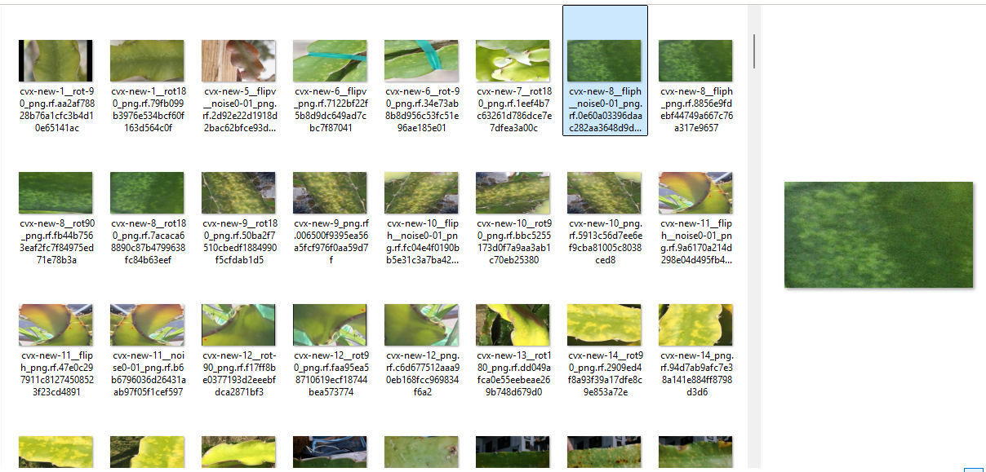
Dataset Used to Train The Model
Dataset used from Roboflow Universe
LINK: https://universe.roboflow.com/yolo-dragonfruit-disease/dfruit-stem-disease-resnet-50/dataset/2
Figure -3: Collections of data

Slide 15
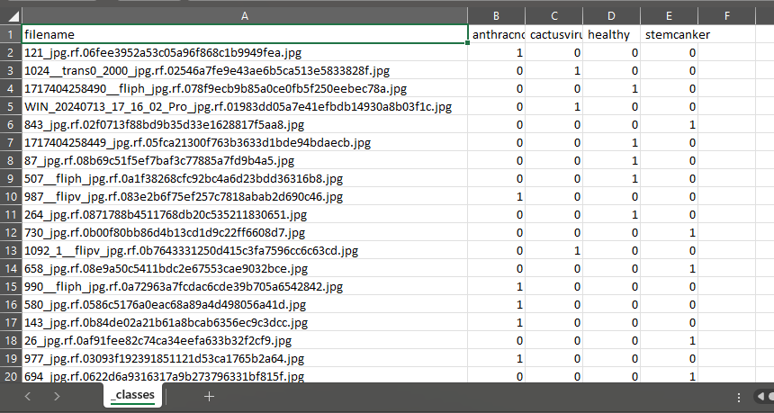
Dataset separation Into Four Classes
Dataset has been separated into four main classes
Four main classes
Diseases
Anthracnose
Cactusvirus
Stemcanker
Healthy
Figure -4: Dataset separation to train the model

Slide 16
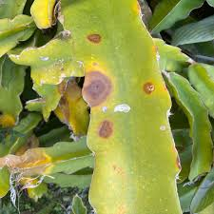
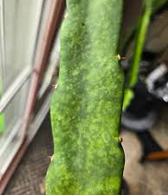
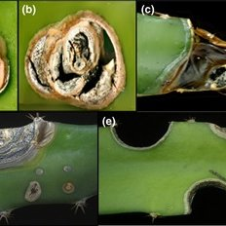
Three Main Diseases
Anthracnose: A fungal disease causing dark, sunken, water-soaked lesions on cladodes and fruit, leading to decay and reduced quality in humid conditions.
Cactusvirus: A viral infection that causes mottling and yellow mosaic patterns on the cladodes and is easily spread by unclean tools.
Stemcanker: A disease that forms sunken, reddish-brown scabs and lesions on the stems, which can girdle the cladodes and cause dieback.
Figure -5:Anthracnose
Figure -6:Cactusvirus
Figure -7:Stemcanker

Slide 17
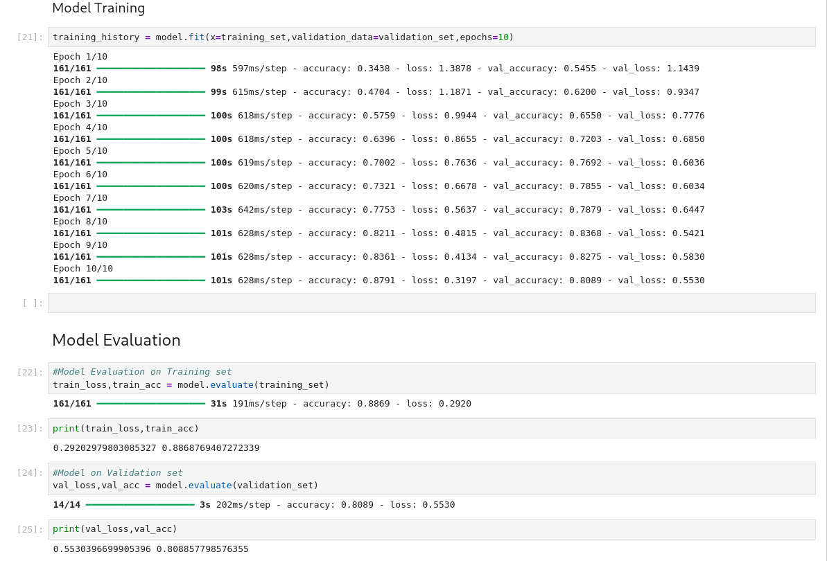
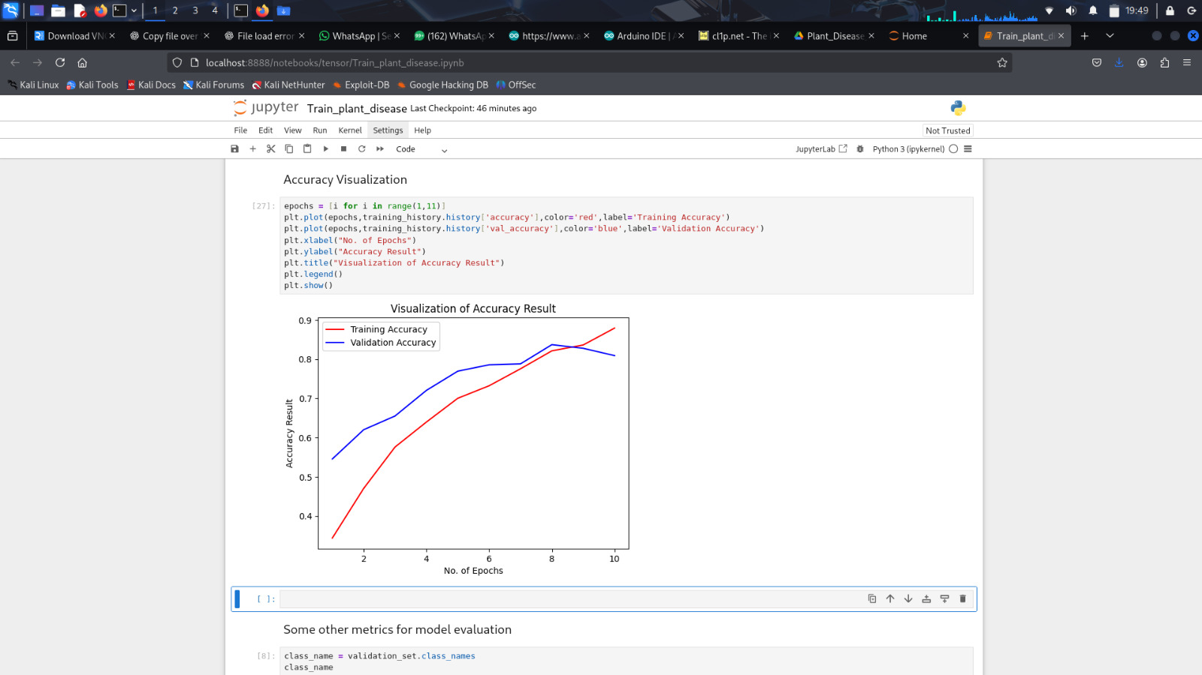
Trained Model Results
Model is trained in Jupiter Notebook using Python
Figure -8: Model getting trained
Figure -9: Trained model accuracy results

Slide 18
Hardware Implementation
Drive System: 4-Wheel Drive (4WD) chassis powered by DC Motors.
Motor Control: L298N H-Bridge Driver used for differential steering.
Controls speed via PWM (Pins 11& 6) and direction via Logic Pins (10,9,8,7).
Sensing: Two IR Sensors (Digital) for line tracking and plant detection.
Dual-Controller Architecture:
Master: Raspberry Pi 3 (Vision, Decision Making, Communication).
Slave: Arduino Uno (Motion Control, Sensor Readings).
Power Supply: (18650 Li-on battery) Battery pack powering motor driver and regulators.

Slide 19
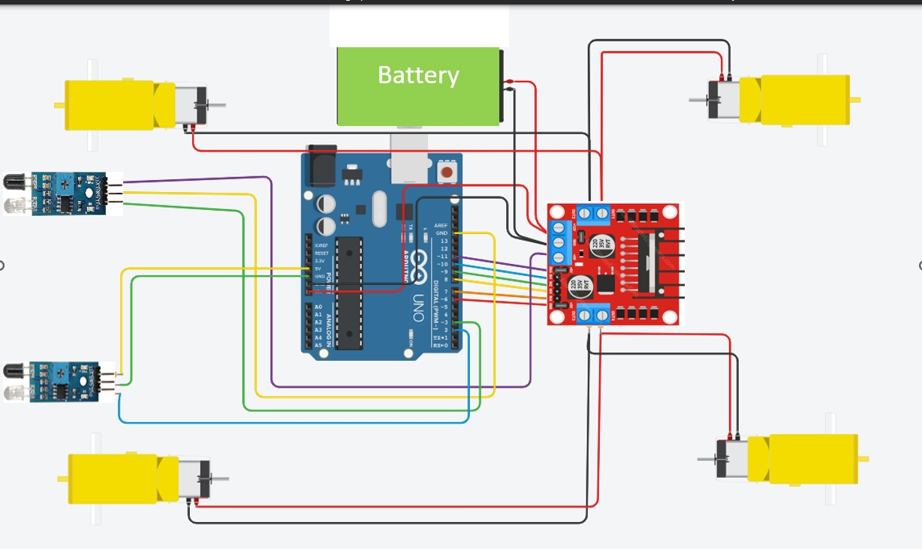
Circuit Design For AgriBot
Figure -10: Circuit Design
Figure -11: Component architecture

Slide 20
Navigation Logic (Arduino)
Dual-Controller Architecture: Operates with a Raspberry Pi 3 (Master) for vision/AI and an Arduino Uno (Slave) for real-time motion control.
Drive System: Features a 4-Wheel Drive (4WD) chassis powered by DC motors and a centralized battery pack for consistent mobility.
Motor Control: Utilizes an L298N H-Bridge driver for differential steering, controlling speed via PWM (Pins 11&6) and direction via Logic Pins (10,9,8,7).
Sensing Module: Equipped with two digital IR sensors to execute real-time line tracking and precise plant position detection.
Figure -12: Navigation logic

Slide 21
Vision & Intelligence (Raspberry Pi)
Deep learning model: Utilizes TensorFlow Lite (TFLite) to execute lightweight, low-latency inference directly on the Raspberry Pi without cloud dependency.
Custom Model Deployment: Runs the TFLite model optimized for recognizing dragon fruit pathologies.
Image Preprocessing Pipeline: Standardizes input data by resizing captures to 128x128 pixels and normalizing to float32 values for accurate model analysis.
Disease Classification: Identifies four specific conditions: Anthracnose, Cactus Virus , Stem Canker, and Healthy.
High-Speed Imaging: Integrates Libcamera-jpeg to perform rapid image capture, ensuring seamless synchronization with the robot's navigation system.
Figure -13: Flow of Raspberry Pi

Slide 22
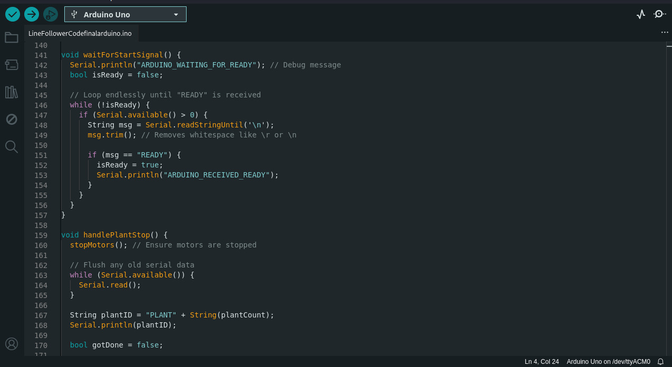
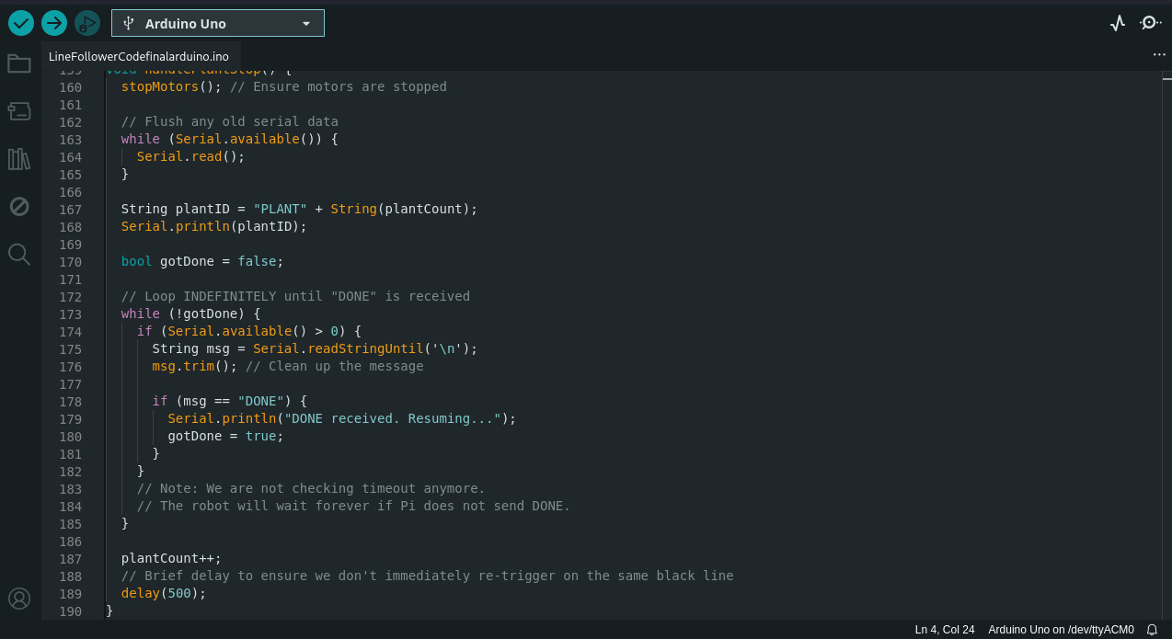
Arduino Uno code
Figure -14: Arduino Uno code

Slide 23
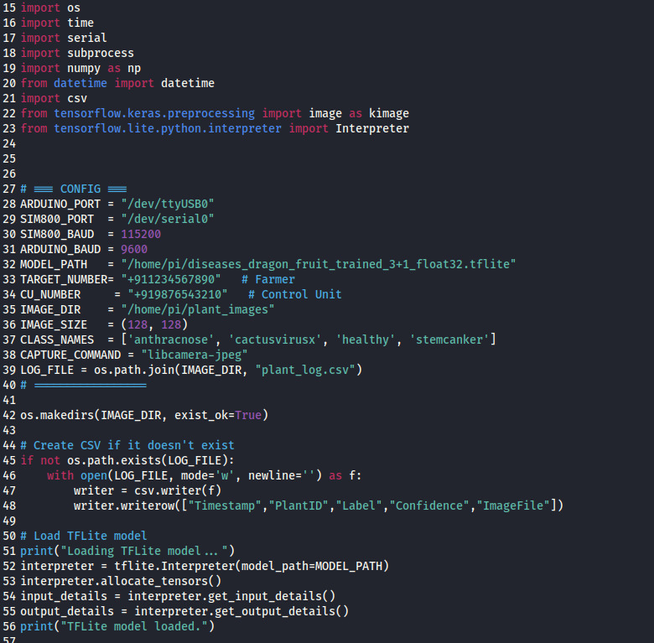
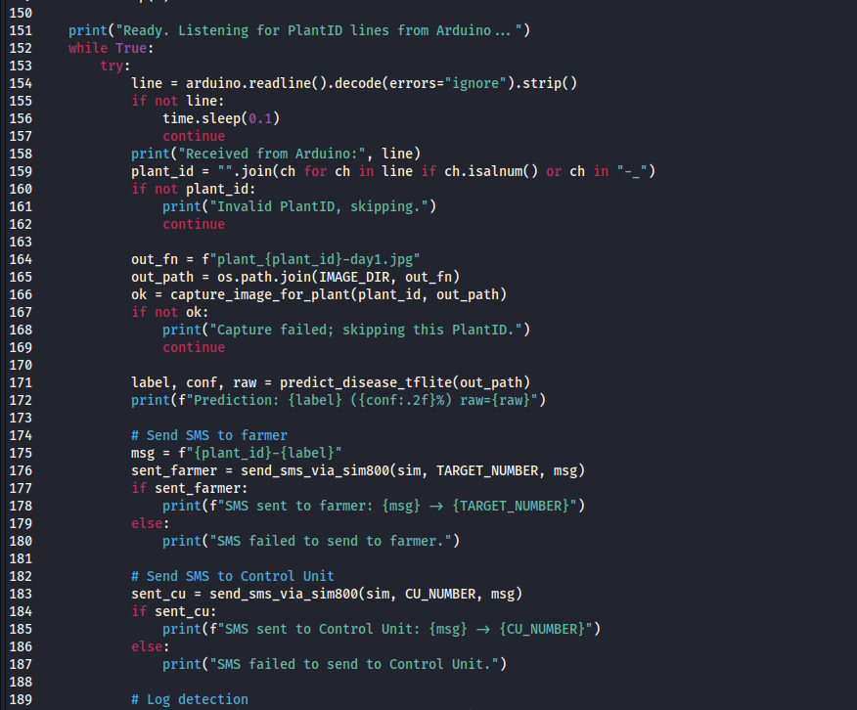
Raspberry Pi code
Figure -15: Raspberry Pi code

Slide 24
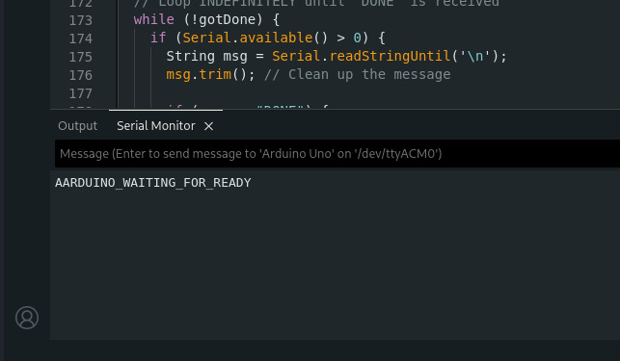
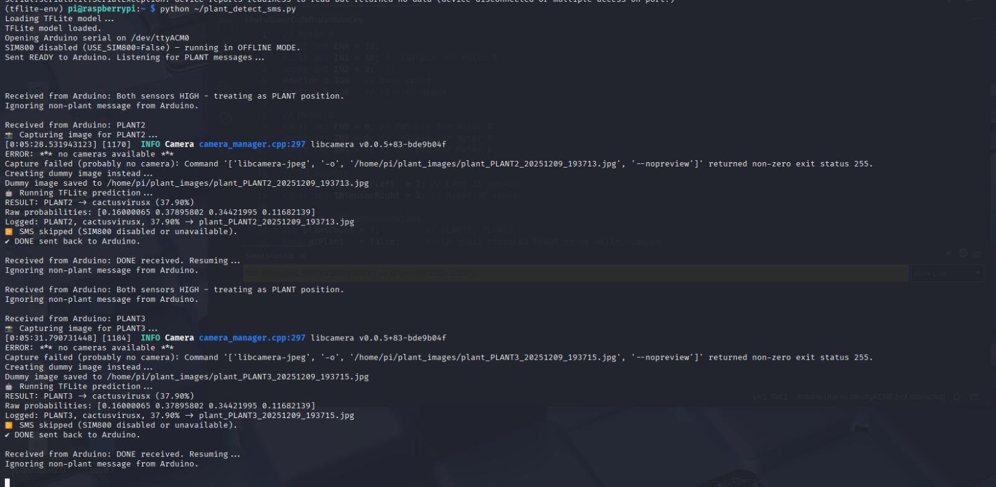
Arduino and Raspberry Pi working
Figure -17:Raspberry Pi Sending the “READY” Command to the Arduino
Figure -16: Arduino Boot Status and Serial Communication Interface

Slide 25
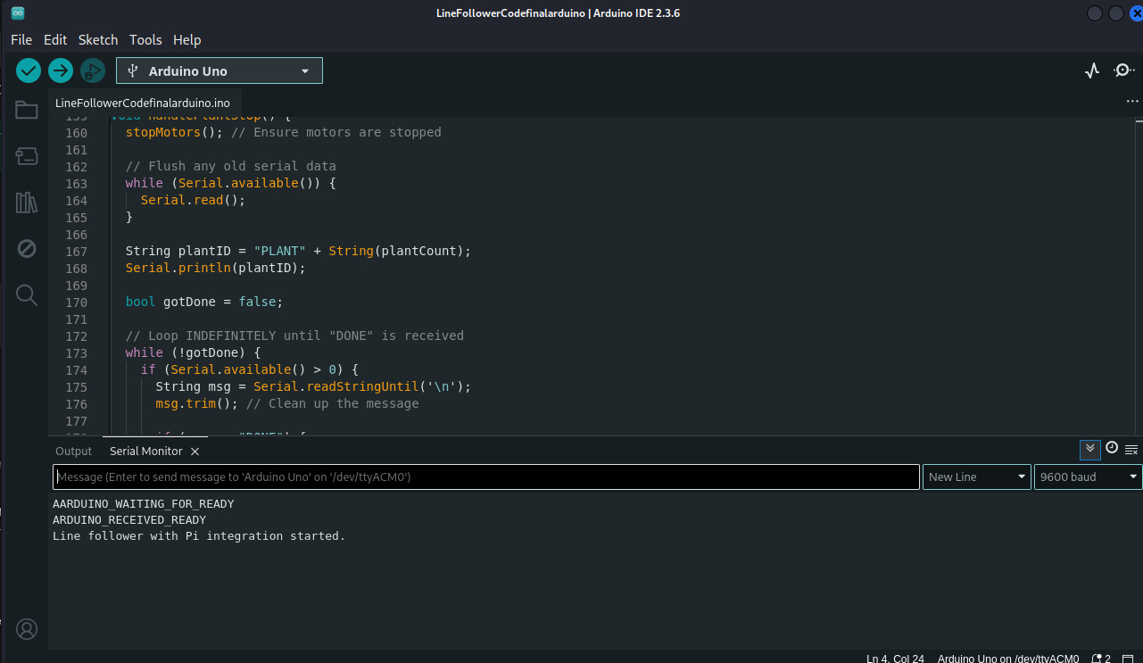
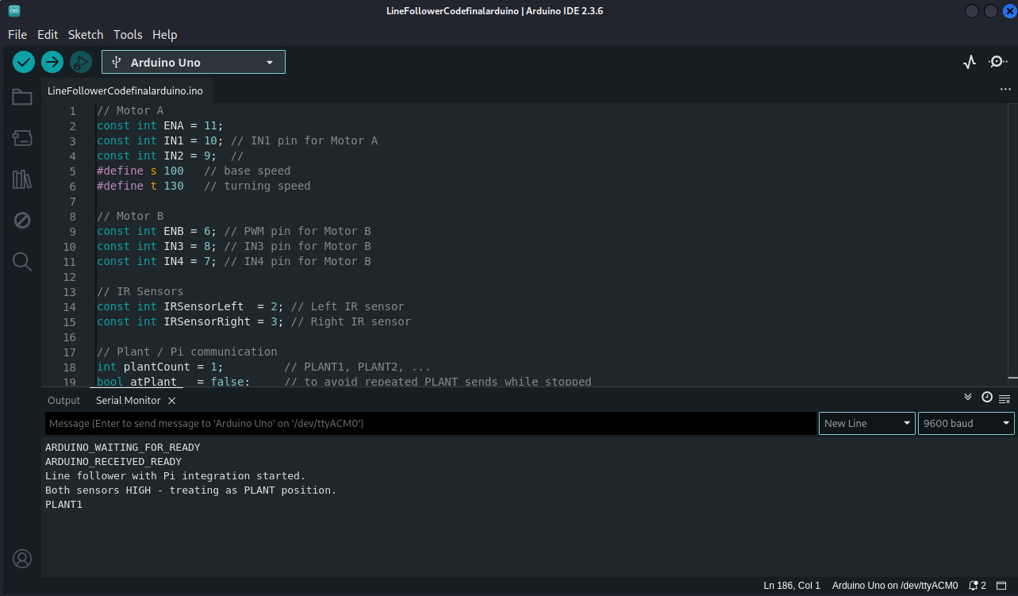
Arduino and Raspberry Pi working (cont..)
Figure -18: Arduino acknowledging READY command and starting line-following operation
Figure -19: Arduino detecting plant position and sending PLANT1 signal to Raspberry Pi

Slide 26
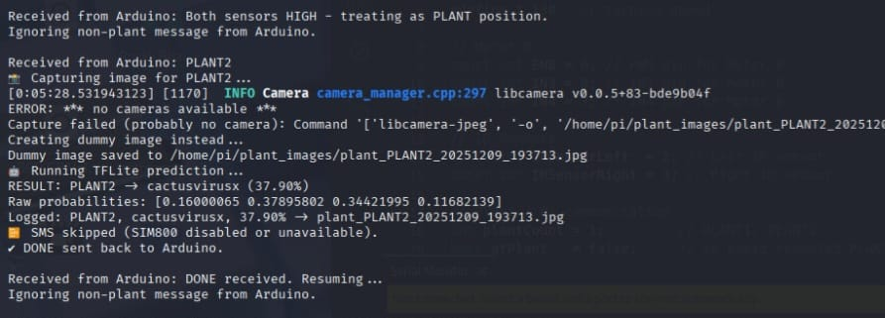
Arduino and Raspberry Pi working (cont..)
Figure -20: Raspberry Pi Processing PLANT Signal and Executing Image Capture & Prediction Pipeline

Slide 27
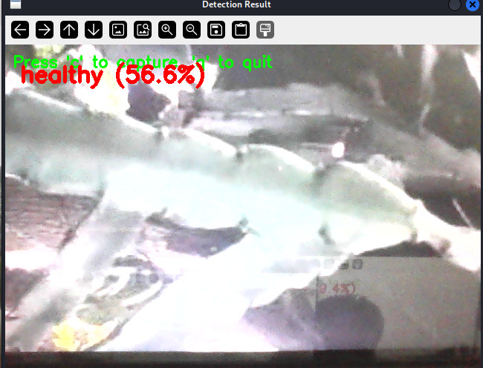
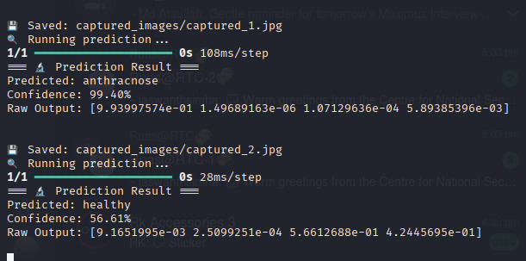
Arduino and Raspberry Pi working (cont..)
Figure -21: Live Detection Window Displaying Health Status of the Plant(for testing)
Figure -22: Raspberry Pi Image Classification Output for Plant Disease Detection

Slide 28
System Integration Results
Phase 1: Completed Implementation
Hardware Integration: Finalized mechanical assembly of the 4WD chassis and complete wiring of the dual-controller system.
Model Deployment: TFLite disease detection model successfully running inference on the Raspberry Pi.
Autonomous Navigation: Arduino reliably executing line following and "stop-and-wait" waypoint logic.
Internal Communication: Stable UART Serial protocol established between Master (Pi) and Slave (Arduino).
IoT Alert System: Real-time SMS notifications triggering correctly via the SIM800 module.

Slide 29
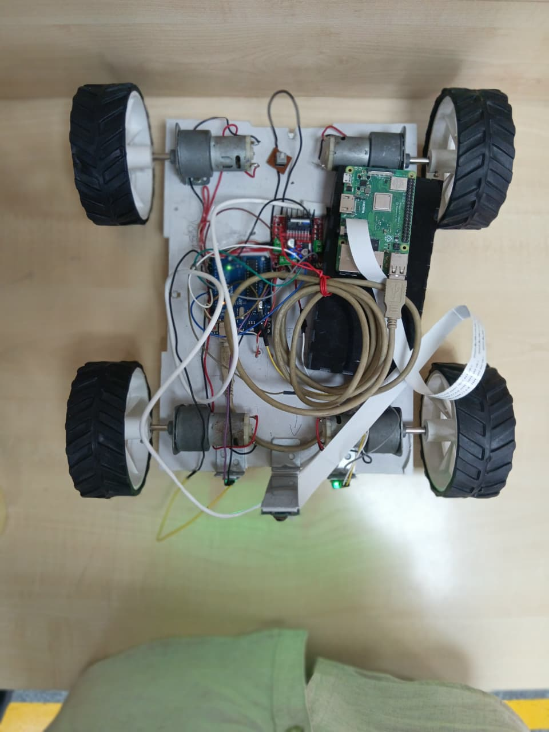
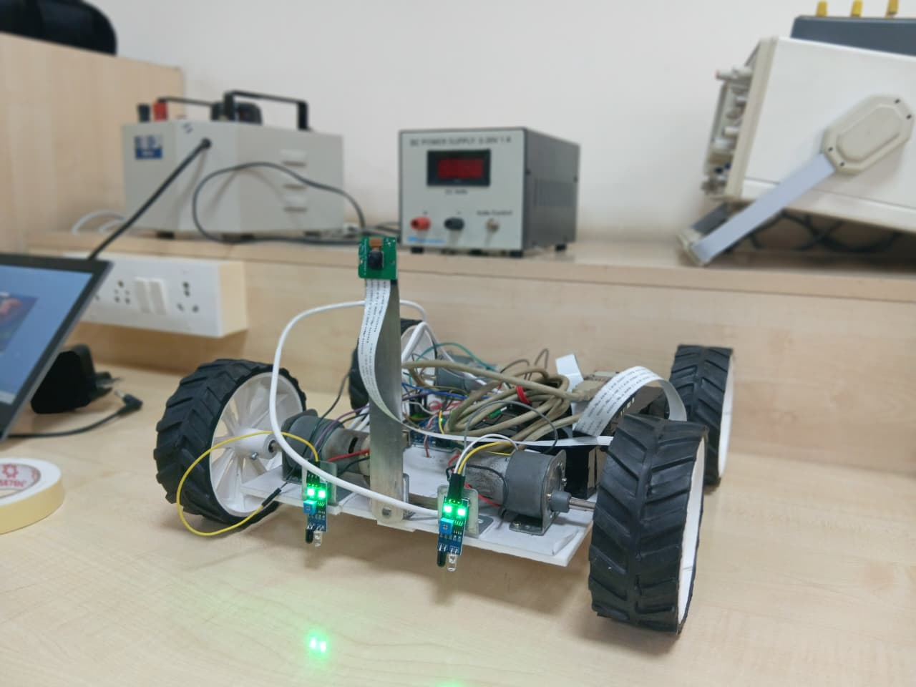
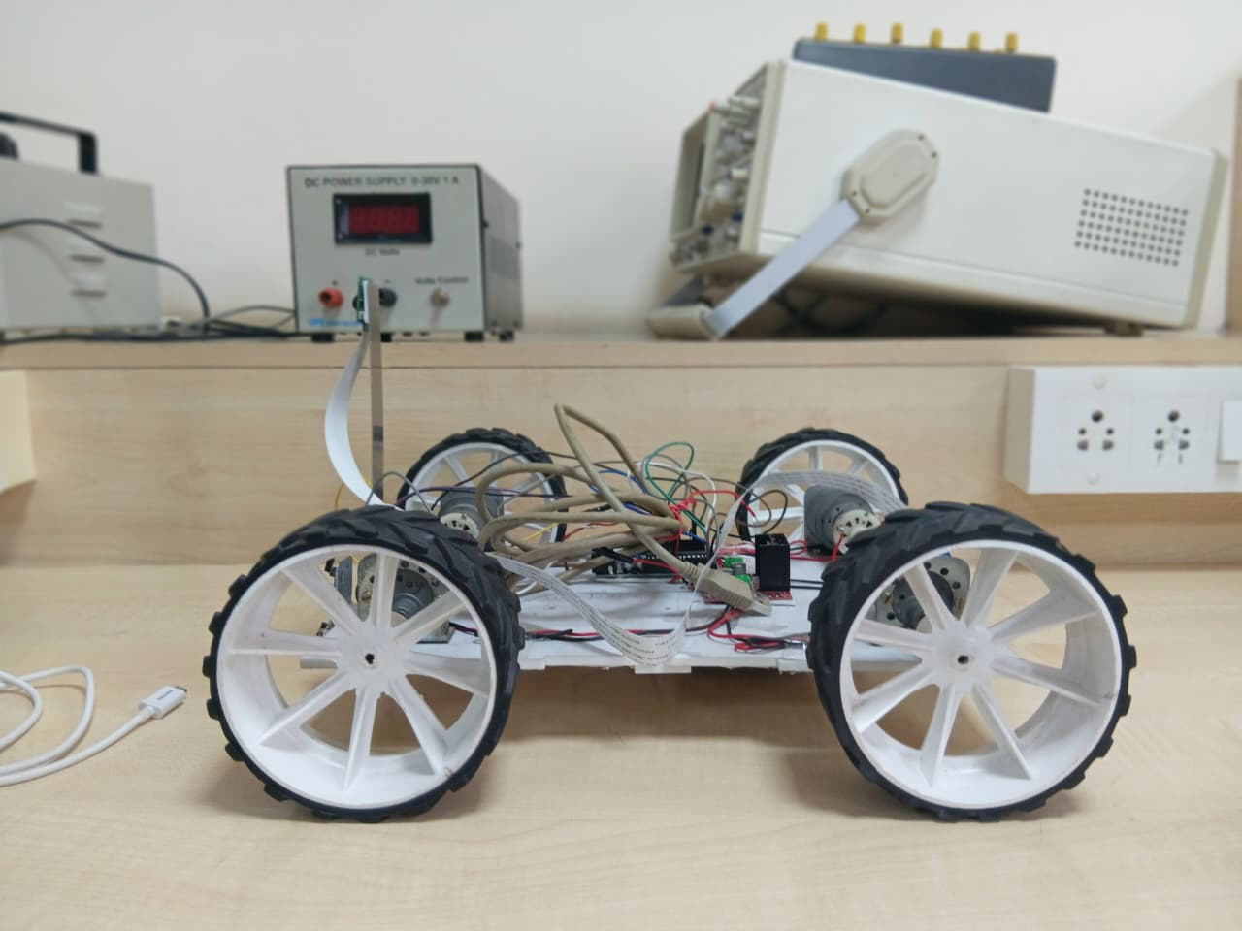
Prototype Model
Figure -23: Prototype Model of Agribot

Slide 30
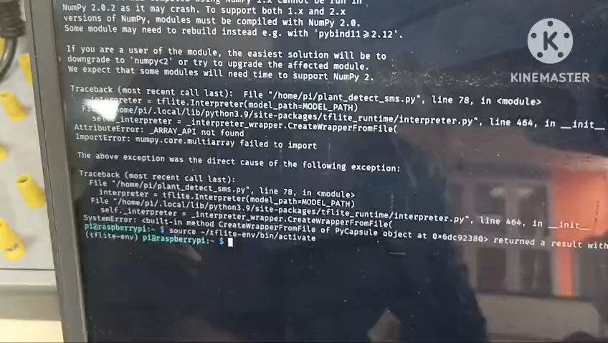
Working Video

Slide 31
Gantt Chart
Project Work (UG) 16 weeks
Week | 1 | 2 | 3 | 4 | 5 | 6 | 7 | 8 | 9 | 10 | 11 | 12 | 13 | 14 | 15 | 16
Major Activities
Literature survey |  | e333
Design and simulation specifications
To design and simulate
To design and simulate
To design and simulate
Interim
To verify and compare
Report
Presentation

Slide 32
References
Mohanty, S.P., Hughes, D.P. and Salathé, M., 2016. Using deep learning for image-based plant disease detection. Frontiers in plant science, 7, p.215232.
Ngugi, H.N., Ezugwu, A.E., Akinyelu, A.A. and Abualigah, L., 2024. Revolutionizing crop disease detection with computational deep learning: a comprehensive review. Environmental Monitoring and Assessment, 196(3), p.302.
Al Mamun, M.R., Ahmed, A.K., Upoma, S.M., Haque, M.M. and Ashik-E-Rabbani, M., 2025. IoT-enabled solar-powered smart irrigation for precision agriculture. Smart Agricultural Technology, 10, p.100773.
Lochan, K., Khan, A., Elsayed, I., Suthar, B., Seneviratne, L. and Hussain, I., 2024. Advancements in precision spraying of agricultural robots: A comprehensive review. IEEE Access.
Mac, T.T., Nguyen, T.D., Dang, H.K., Nguyen, D.T. and Nguyen, X.T., 2024. Intelligent agricultural robotic detection system for greenhouse tomato leaf diseases using soft computing techniques and deep learning. Scientific Reports, 14(1), p.23887.
Suhag, S., Singh, N., Jadaun, S., Johri, P., Shukla, A. and Parashar, N., 2021, June. IoT based soil nutrition and plant disease detection system for smart agriculture. In 2021 10th IEEE international conference on communication systems and network technologies (CSNT) (pp. 478-483). IEEE.

Slide 33


